Slide 1
Socket Programming - II
Computer Networks

Slide 2
What will you learn?
Socket Programming
Event-driven programming

Slide 3
Socket Programming

Slide 4
TCP Stream Socket
Reliable
Handles packet loss.
In-order delivery.
Requires acknowledgement.
Has Congestion control.
Similar to telephone connection.

Slide 5
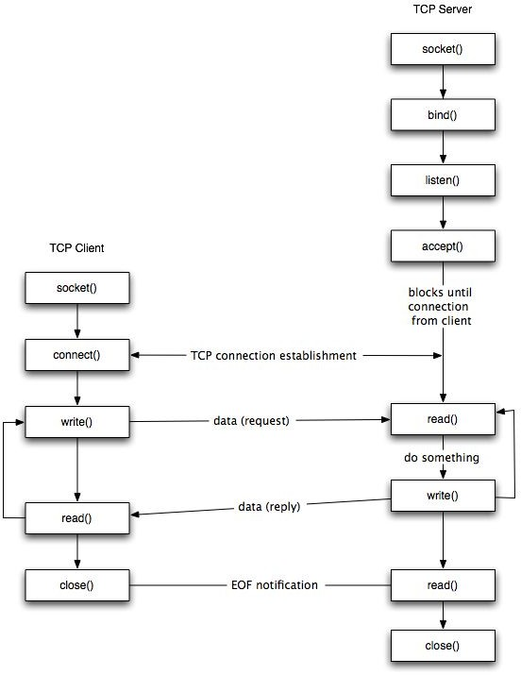
TCP Client-Server Model

Slide 6
How would you implement a server?

Slide 7
Single threaded TCP server
Connection Request
Listening Socket
Server Process
Client 1
IP:Port

Slide 8
Single threaded TCP server
Server Process
Client 1
Connected Socket
Connection

Slide 9
Multi threaded TCP server
Connection Request
Listening Socket
Server Process
Client 1
IP:Port

Slide 10
Multi threaded TCP server
Listening Socket
Server Process
Client 1
Connection
Connected Socket
^{Thread}

Slide 11
Multi threaded TCP server
Connection Request
Listening Socket
Server Process
Client 2
IP:Port
Connected Socket
^{Thread}
Client 1
Connection

Slide 12
Multi threaded TCP server
Connection
Client 2
Connected Socket
^{Thread}
Listening Socket
Server Process
Client 1
Connected Socket
^{Thread}
Connection
All the sockets are associated with a single port in the server process.

Slide 13
Event-driven Programming

Slide 14
poll(), select(), epoll()
How to monitor a lot of file descriptors for new input/output ? Who needs to watch a lot of file descriptors at a time?
Servers!
For example if you’re writing a web server in node.js on Linux, it’s actually using the epoll Linux system call under the hood.

Slide 15
A web server may simultaneously be handling thousands of connections. To process and respond to new data that is sent to the server over such connections, it must be aware of when it is received.
It can have a for loop which runs like : For con in open_connections:
If has_new_input(con):
prcoess_input(con)
OS wastes CPU cycles asking the resource every few clock cycles “are you free” . Busy waiting, also known as spinning, or busy looping is a process synchronization technique in which a process/task waits and constantly checks for a condition to be satisfied before proceeding with its execution.

Slide 16
SELECT:
select is one of the oldest methods for event-driven programming in Unix-like systems.
It allows a program to monitor multiple file descriptors (such as sockets or file handles) for readiness to read or write.
You can use select to wait for events on multiple file descriptors without blocking the entire program.
It uses a bitmask to represent file descriptors and can handle a limited number of file descriptors (usually 1024 or less).
While select is portable and widely supported, it can become inefficient when dealing with a large number of file descriptors due to the linear scanning of the descriptor set.

Slide 17
POLL
poll is a more modern alternative to select and is also used for event-driven programming.
It allows a program to monitor multiple file descriptors for events similarly to select. poll is more efficient than select when dealing with a large number of file descriptors, as it doesn't use bitmasks.
However, like select, poll still requires iterating over all monitored descriptors to find events, which can be a performance bottleneck for large numbers of descriptors.

Slide 18
EPOLL(Linux-specific)
epoll is a highly efficient event-driven mechanism available on Linux systems.
It is specifically designed to scale well with a large number of file descriptors.
epoll uses a system call-based approach, which means the kernel notifies the program only when events occur, reducing the need for constant iteration.
epoll provides better performance and scalability compared to select and poll, especially in high-traffic and high-concurrency scenarios.
It supports edge-triggered and level-triggered modes for event notification.

Slide 19
Difference between Poll and Select
Given a list of file descriptors, they tell you which ones have data available to read/write to.
select and poll fundamentally use the same code. poll returns a larget set of possible results for file descriptors like POLLRDNORM, POLLRDBAND, POLLIN, POLLHUP, POLLERR, while select just tells you there's input/output/error.
poll can perform better than select if you have a sparse set of file descriptors. poll takes a pollfd argument to specify which file descriptors to monitor; select takes bitsets and loops the whole range.

Slide 20
Implementation
When implementing event-driven programming using these mechanisms, you typically follow these steps:
Create and initialize the event monitoring mechanism (select, poll, or epoll).
Register file descriptors that you want to monitor for events.
Wait for events to occur. The mechanism will notify your program when an event occurs on one or more registered file descriptors.

Slide 21
Handle the events by invoking the appropriate event handlers or processing the I/O operations associated with the events.
Repeat the process as needed for ongoing event monitoring.

Slide 22
Why use epoll?
The kernel must check all of the specified file descriptors to verify if they are ready on each call to select() or poll(). The time needed for this process substantially outweighs when monitoring a high number of file descriptors
The Linux kernel receives a list of file descriptors to track and updates about activity on those file descriptors via the epoll group of system functions (epoll create, epoll ctl, and epoll wait).
Steps:
Tell the kernel you're going to be epolling by calling epoll_create(). It returns an ID to you.
Inform the kernel file descriptors that you want updates on them by calling epoll_ctl().
Call epoll_wait() to wait for updates about the list of files you’re interested in.

Slide 23
Epoll API
#include <sys/epoll.h>
int epoll_create(int size);
int epoll_create1(int flags);
int epoll_ctl(int epfd, int op, int fd, struct epoll_event *event);
int epoll_wait(int epfd, struct epoll_event *events, int maxevents, int timeout);
struct epoll_event {
uint32_t events; // Bitmask of events to monitor (EPOLLIN, EPOLLOUT, etc.)
epoll_data_t data; // User data associated with the file descriptor
};

Slide 24
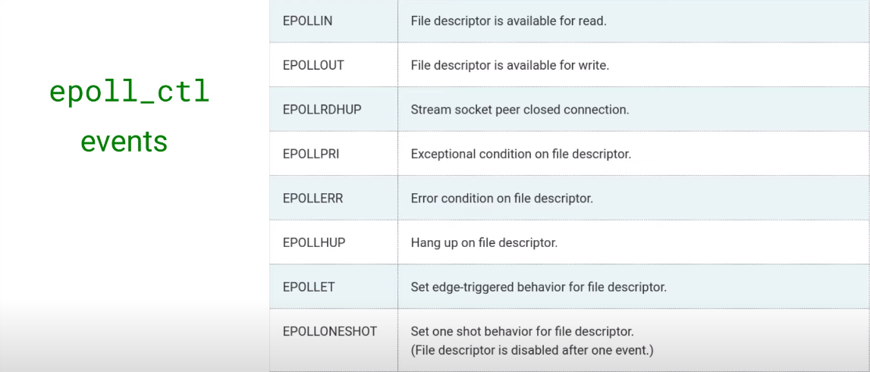
EPOLL EVENTS

Slide 25
References
LibC wrapper on bind system call
LibC wrapper on listen system call
LibC wrapper on accept system call
LibC wrapper on connect system call
Concurrent Server
LibC wrapper on clone system call
Linux Programming Interface
Select, Poll, and Epoll
For Epoll API

